Slide 1
Merging branches and resolving Merge conflicts
Presentation by: Teijas Saini (12312001) & Rushil Jain (12312018)
[Group – 13]

Slide 2
Basic Branching and Merging Case Study
Let’s go through a simple example of branching and merging with a workflow that you might use in the real world.
We’ll follow these steps:
Do some work on a project.
Create a branch for a new user story you’re working on.
Do some work in that branch.
At this stage, we’ll receive a call that another issue is critical and you need a hotfix. We’ll do the following:
Switch to your production branch.
Create a branch to add the hotfix.
After it’s tested, merge the hotfix branch, and push to production.
Switch back to your original user story and continue working.

Slide 3
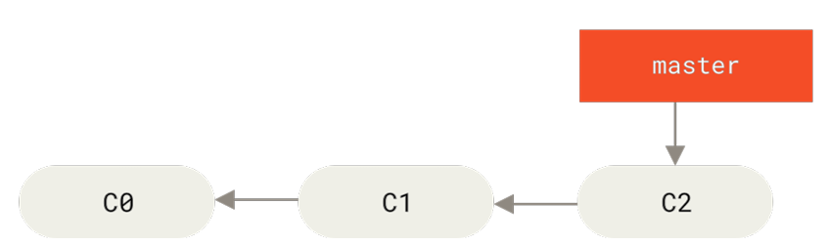
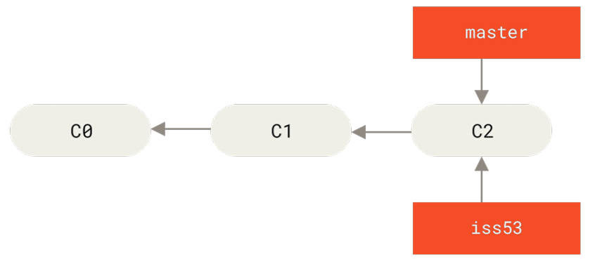

Merging Branches
First, let’s say we’re working on a project and have a couple of commits already on the master branch.
We’ve decided that we’re going to work on issue #53.
To create a new branch and switch to it at the same time, you can run the git checkout command with the -b switch:
We work on iss53 branch and do some commits. Doing so moves the iss53 branch forward, because we have it checked out (that is, our HEAD is pointing to it)

Slide 4
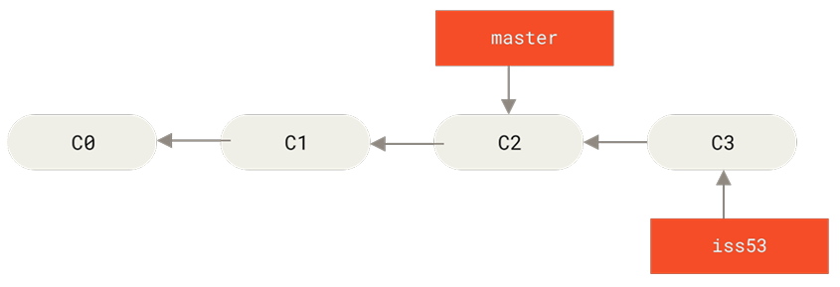
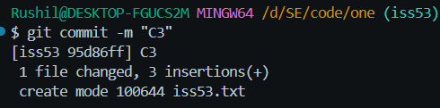
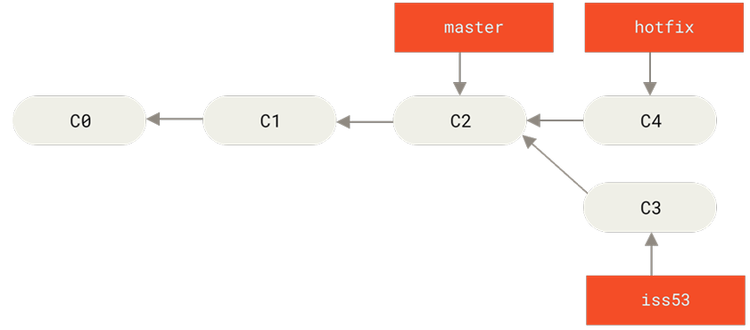

We work on iss53 branch and do some commits. Doing so moves the iss53 branch forward, because we have it checked out (that is, our HEAD is pointing to it)
If upon receiving a production issue, there's no need to revert the `iss53` changes. Simply switch to the `master` branch and apply the necessary fix.
Next, we have a hotfix to make. Let’s create a hotfix branch on which to work until it’s completed.

Slide 5
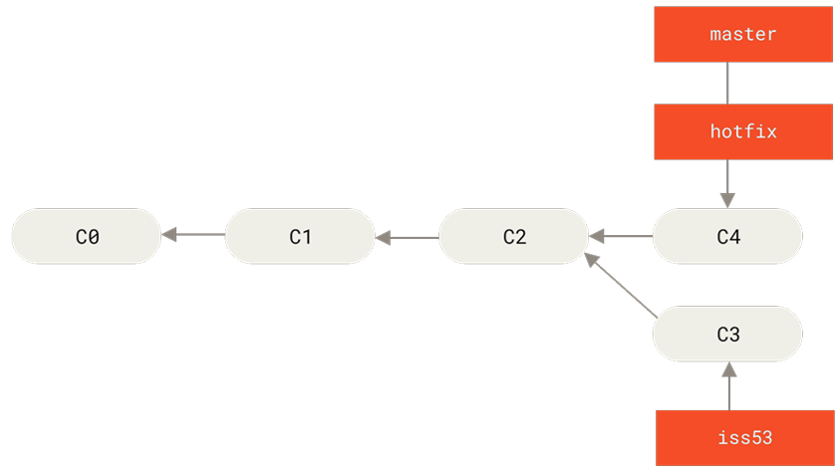
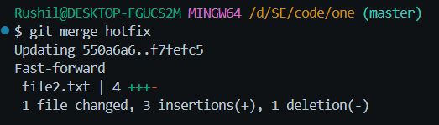

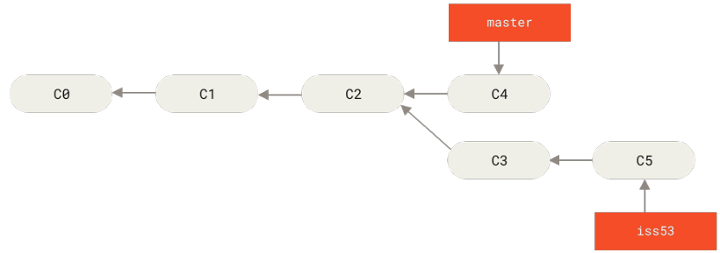
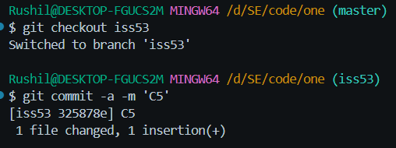
We have resolved the issues in the hotfix branch and tested the changes. Now, we can merge it with the master branch (This type of merge is Fast-forward merge).
Now, we have no use of the hotfix branch, so let’s delete it.
Now we can switch back to our work-in-progress branch on issue #53 and continue working on it.

Slide 6
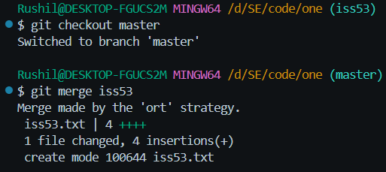
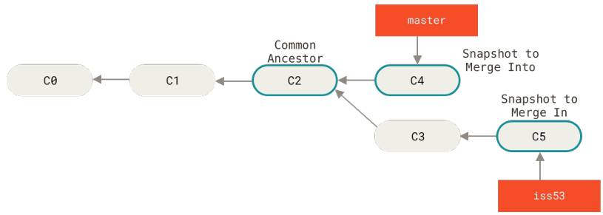
Once issue #53 is complete, we switch to the master branch and run git merge iss53 to integrate the changes.
Ostensibly recursive twin (ORT) is a new merge strategy used by git. It gives the same result as that of the traditional three-way merge.
When branches diverge, git performs a three-way merge using the two latest commits and their common ancestor, since the current branch isn’t a direct ancestor of the one being merged.

Slide 7
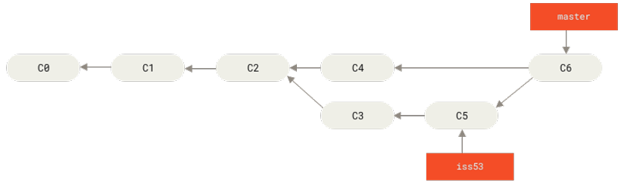
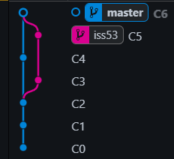
Instead of just moving the branch pointer forward, Git creates a new snapshot that results from this three-way merge and automatically creates a new commit that points to it. This is referred to as a merge commit, and is special in that it has more than one parent.
This is a VS Code Extension (Git Graph) which helps us understand the branching structure. We can also use the `git log –graph` command to do the same in the terminal in ASCII format.

Slide 8
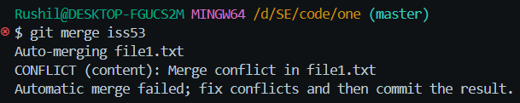
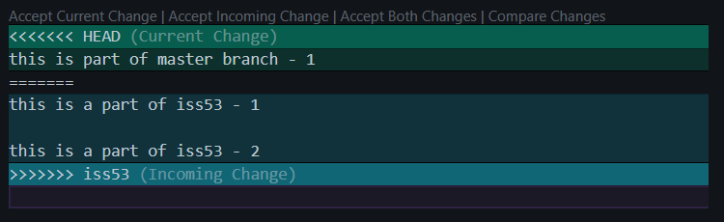
Basic Merge Conflict
Occasionally, the merging process doesn’t go smoothly. If we changed the same part of the same file differently in the two branches we’re merging, Git won’t be able to merge them cleanly.
If we fix for issue #53 and modified the same part of a file as the master branch, you’ll get a merge conflict that looks something like this -
Git adds standard conflict-resolution markers to the files that have conflicts, so you can open them manually and resolve those conflicts. The conflicted file contains a section that looks something like this:

Slide 9
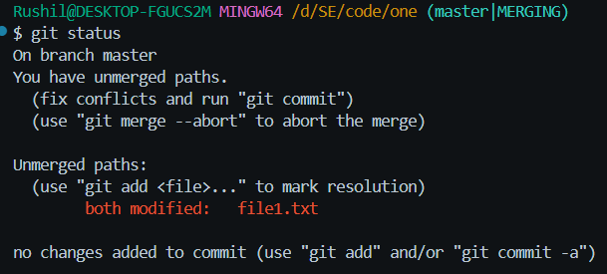
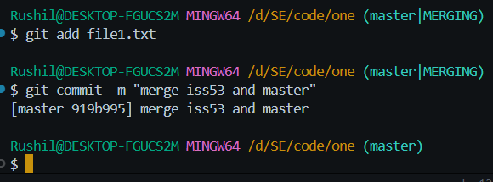
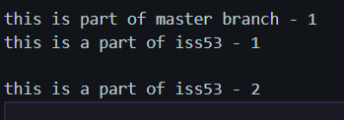
Git hasn’t automatically created a new merge commit. It has paused the process while you resolve the conflict. If you want to see which files are unmerged at any point after a merge conflict, you can run git status:
In order to resolve the conflict, we have to either choose one side or the other or merge the contents ourself.
We have accepted both changes in this example

Slide 10
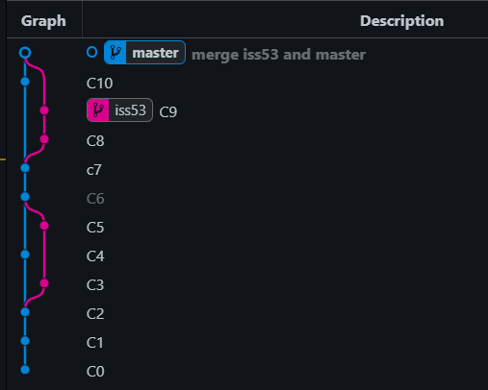
The <<<<<<, =======, >>>>>> lines have been completely removed. After we’ve resolved each of these sections in each conflicted file, run git add on each file to mark it as resolved. Staging the file marks it as resolved in Git.
Here is the final git branches graph of our entire workflow
Undoing a merge conflict –
If we messed up some things, we can always undo the merge commit using the command, `git merge –abort`

Slide 11
THANK YOU

